Slide 1

In the name of Allah, the most Beneficent and Merciful

Slide 2
FEATURES:
Current Measurement.
Voltage Measurement.
Temperature and Humidity Measurement.
Automatic Battery Charging.
Full Load Control.
Dry and Wet Cleaning.
Timing Control.

Slide 3
COMPONENTS:
2-channel Relay Module.
Ds3231 RTC Module.
ACS712-5A.
Voltage Sensor.
DHT-11 Temperature and Humidity Sensor.
Ultrasonic Sensor.
24V Lead Acid Battery.
PWM Solar charge Controller.
BTS7960 PWM Motor Driver.
MP2307 Mini DC Buck Converter
16x4 LCD.
2.5A Gear Motor.
37V/7A Solar Plate.
12V Water Pump.
Arduino Mega.

Slide 4
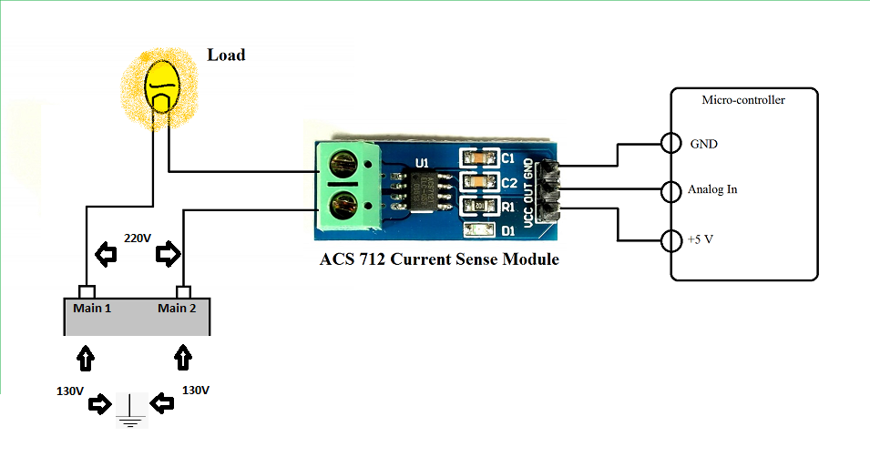
1. Current Sensor:

Slide 5
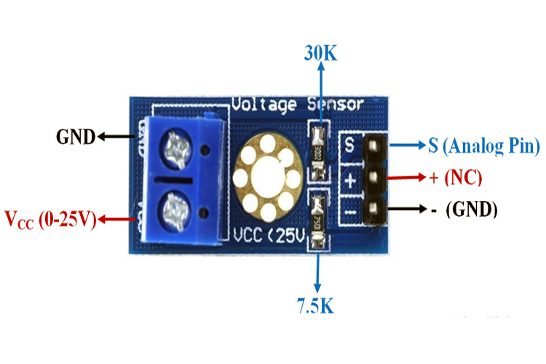
2. VOLTAGE SENSOR:

Slide 6
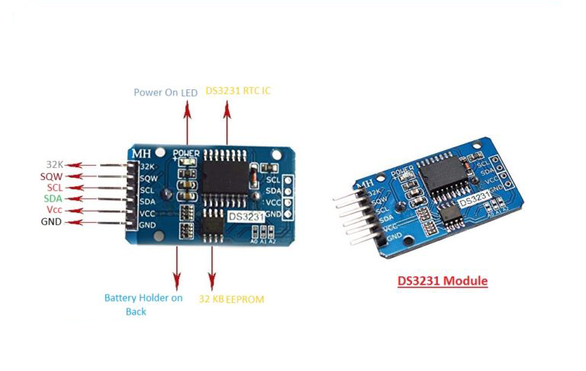
3. DS3231 RTC:

Slide 7
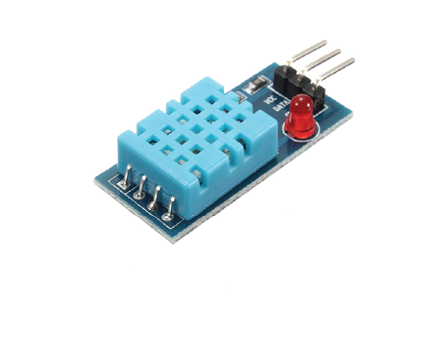
4. DHT-11 Sensor:

Slide 8
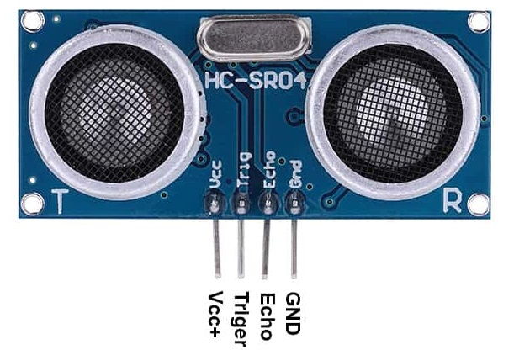
5. Ultrasonic Sensor:
3x Ultrasonic Sensors.

Slide 9
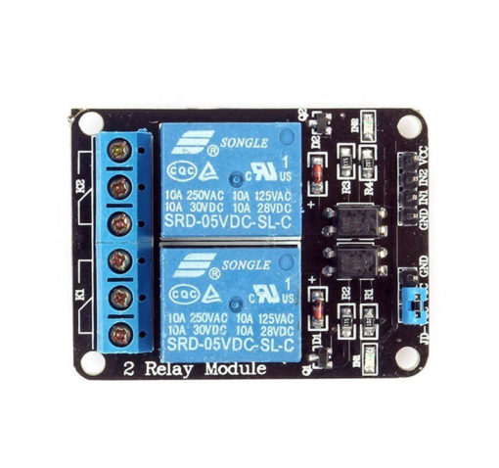
6. 2-CHANNEL RELAY MODULE:

Slide 10
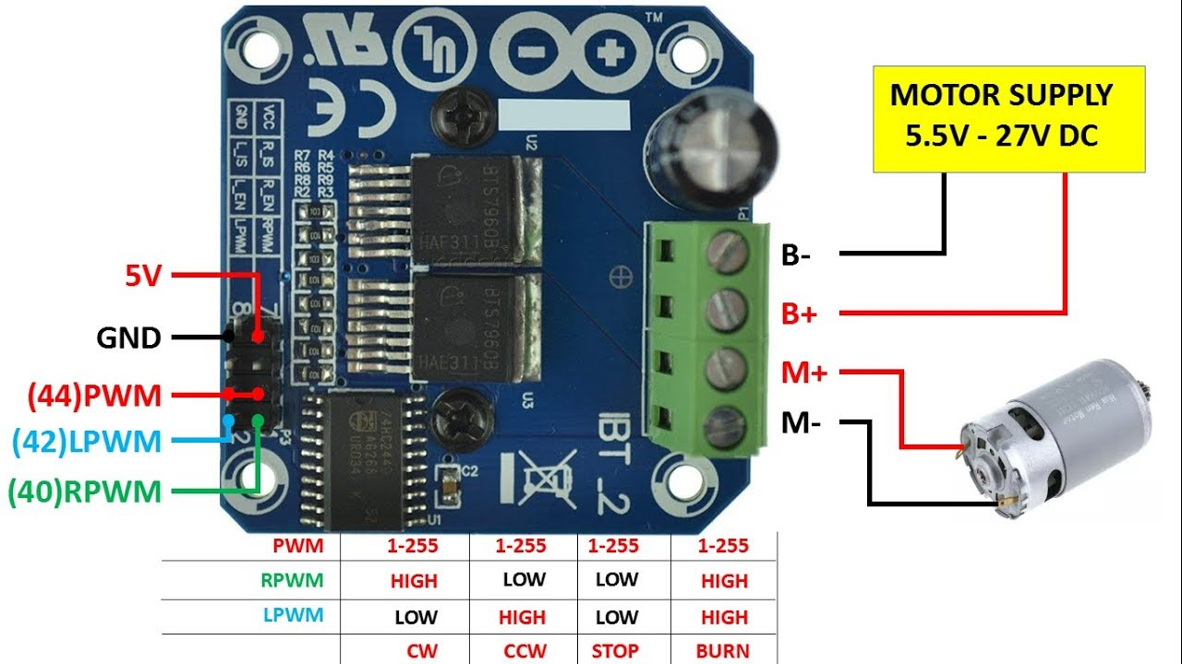
7. HIGH CURRENT MOTOR DRIVER:
Input voltage: 6V-27V
Maximum current: 43A
2x

Slide 11
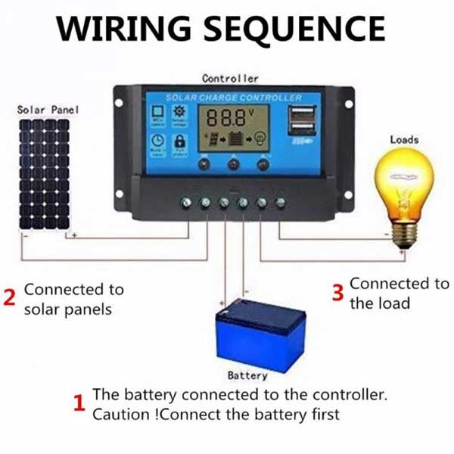
8. PWM SOLAR CHARGE CONTROLLER
Built-in Micro-controller.
Adjustable charge / discharge parameters
Battery deep drain (low voltage) protection
Automatic System Voltage Identification.
Overload and Short circuit protection
5V/2A Dual USB O/P.
3x Control Buttons
Battery Option
  (Gel, Lead-Acid, FLOODED, Lithium-ion LiFePO4)
Full Load Control.
  Load On control when battery>threshold
  Load Off control when battery< threshold
  Manual Load On/Off.
https://www.solorder.se/image/data/uploads/KLD1210.pdf

Slide 12
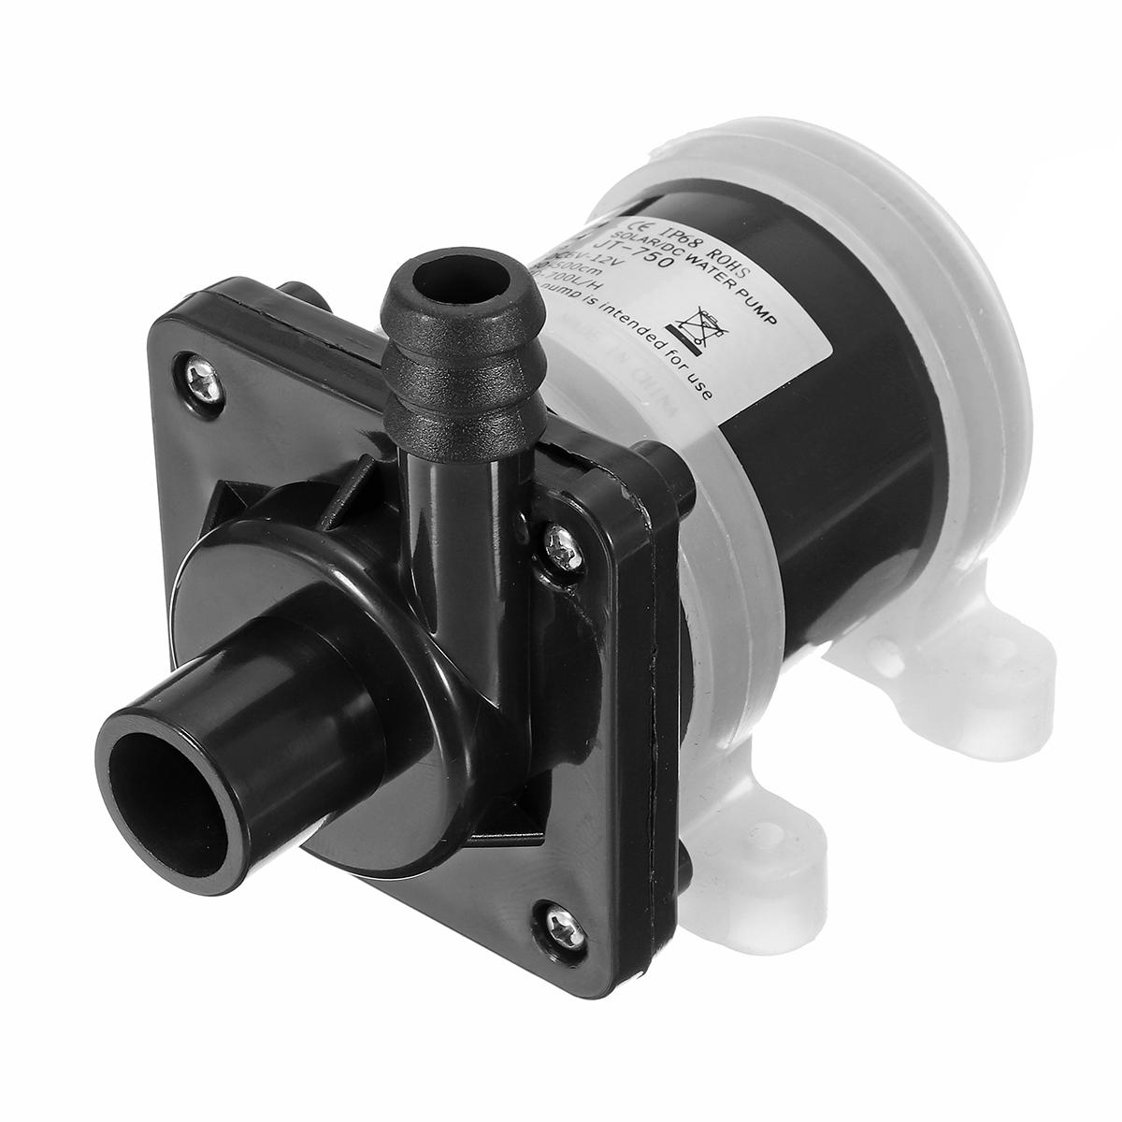
9. 12V WATER PUMP:

Slide 13
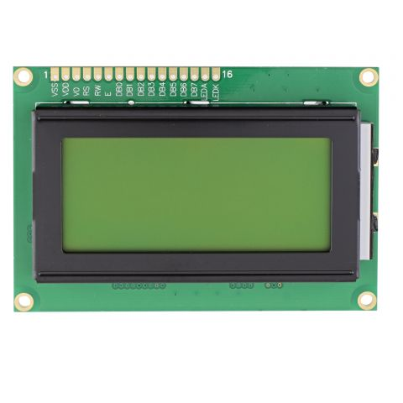
10. 16x4 LCD

Slide 14
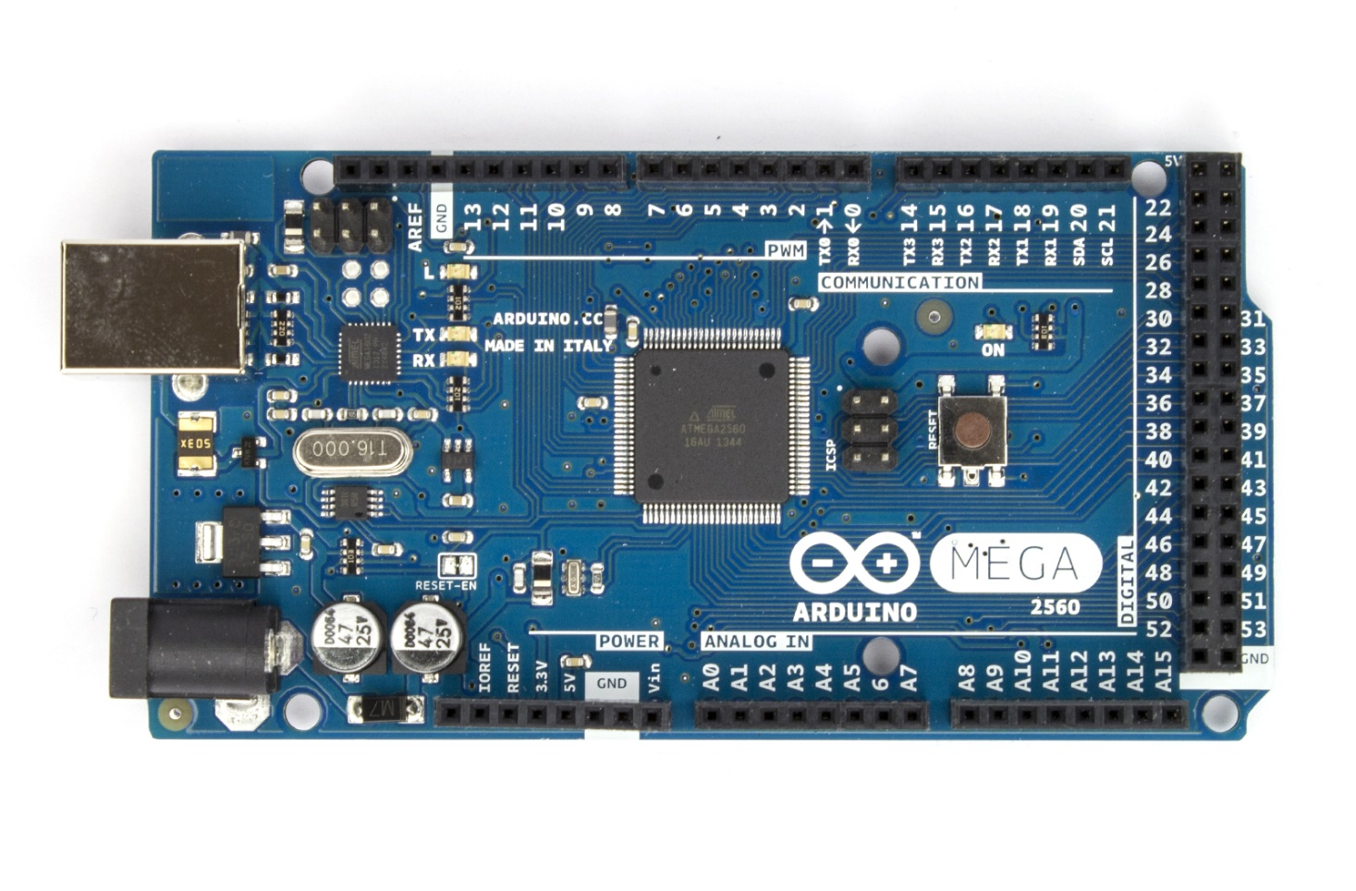
11. Arduino MEGA :

Slide 15
